Slide 1
Mobile App Design Project Proposal
Topic:
Handwriting Recognition combined Calculator
楊世騰 311510032
黃景瑄 311510033
許宏澤 311510034
陳柏翰 311510061
(AI)
Notes:
Hello everyone, today we are going to introduce our final project
Handwriting recognition calculator
好，接下來我們會介紹我們的期末專題報告，(自我介紹)，我們的主題是手寫辨識計算機

Slide 2
Outline
01
02
03
Motivation
How to apply deep learning in React
Result
04
Future work
Notes:
This is our outline, first, we will introduce our motivation.
Second, we’ll simply introduce how we use the machine learning model in our code
Then we’ll focus on what we did in the code and the effort we made.
Lastly, we will provide some thoughts for future work.
這是我們的outline，首先會先簡單講一下我們的動機，並介紹我們使用什麼套件將maching learning model應用在我們的程式，
再來我們會主要著墨在我們目前做出來的結果，並提一下這樣的想法未來可以怎麼使用。

Slide 3
01
Motivation
(AI)

Slide 4
Motivation
Fast speed and Component-based development in React
Image recognition is powerful in mobile app
Model compression for mobile app
Future development of AI application
Notes:
The main motivation for doing this project is that we want to make an application related to Artificial intelligence.
In order to combine with react, we choose the handwriting to be the combined object.
That is because figure recognition is common and developmental in the recent year. Besides, we want to combine model compression in our project.
Thus, we choose a model that we can handle but is still challenging in our task.
那我們最主要的動機是因為我們想要做一些關於AI的應用，而為了結合react，我們選擇了在日常生活中常見的手寫辨識來作為react結合的對象。
主要原因是因為圖像辨識目前在手機app非常常見，也很有許多使用性，再來是我們想要加入model compression在我們的project之中。
而這樣手機的AI應用我們認為在未來是有很多發展性的。

Slide 5
02
How to apply deep learning in React
(AI)

Slide 6

Introduction of Tensorflow.js
TensorFlow.js is a library for running machine learning models in the browser and Node.js. It offers several features and tools that allow developers to use TensorFlow for deep learning and machine learning in frontend and backend environments.
Notes:
We use tensorflow.js, it’s a javascript library for us to load the model we train from tensorflow. After that, we can call it in our code as a function. Then we can use it to predict what we input.
那我們使用的是TensorFlow.js的套件來將我們用tensorflow做出來的maching learning model引入到我們的程式之中，除此之外Tensorflow.js提供許多工具讓我們可以在製作網頁時使用，後面會有我們實際使用的詳細介紹。

Slide 7
03
Result
(AI)

Slide 8
Result
(a) Painters
Painters are made for drawing input pictures.
(b) Color button
The buttons are made for choosing the color.
(c) Calculator
The calculator is combined with the predicted result
Notes:
Our programming can be divided into five part
Painter, color button, calculator,
我們的程式主要可以分成5個使用部分，
分別是畫布筆刷樣式、 顏色的選擇按鈕、計算機、訓練模型以及模型壓縮

Slide 9
Result
(d) Train the model
The model is trained by ourself instead of using the pre-train model.
(e) Model Compression
Applications of model compression are expected in our code.
Notes:
train model and model compression

Slide 10
(a)
Painter
(AI)
Notes:
Now let’s talk about painter

Slide 11
(a) Painter
Index.js
NumberRecognition.js
drawable_canvas.js
Flow chart
Notes:
First, this is the painter’s flow chart.
We can see that index.js has a child component called number recognition.
Then number recognition also has a child component called drawable canvas
首先這是painter功能的組件關係圖，可以看到index有一個子組件NumberRecognition，而NumberRecognition還有一個子組件drawable_canvas

Slide 12
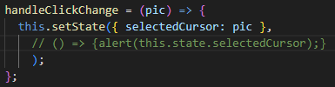
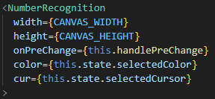
(a) Painter
index.js
Notes:
In the code, I put the five painter figures for choosing.
When the figure is chosen, we will change the state to the figure we want by function handleclickchange
Then the state of index.js will be sent to number recognition component as an attribute
首先我先在index.js中放置五種畫布筆刷圖案做選擇，而當圖案被選擇時，會藉由handleClickChange改變state到所選擇的圖案，
而index.js的state會傳入NumberRecognition componen的cur的 attribute

Slide 13
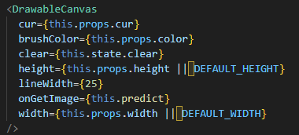
(a) Painter
number-recognition.js
Notes:
Following the same concept, the figure information will be sent to drawable-canvas component as an attribute
這個傳入到Number-recognition的屬性會再被傳入DrawableCanvas component 的cur attribute

Slide 14
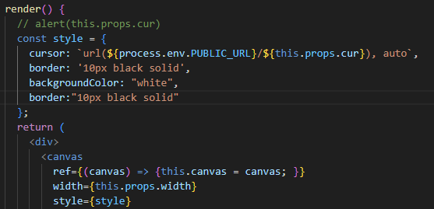
(a) Painter
drawable_canvas.js
Notes:
Then, we can set the figure information in our drawable-canvas component
這時候，我們的畫布筆刷圖案就被傳到我們的畫布組件，我們便可以將該圖案設置成筆刷

Slide 15
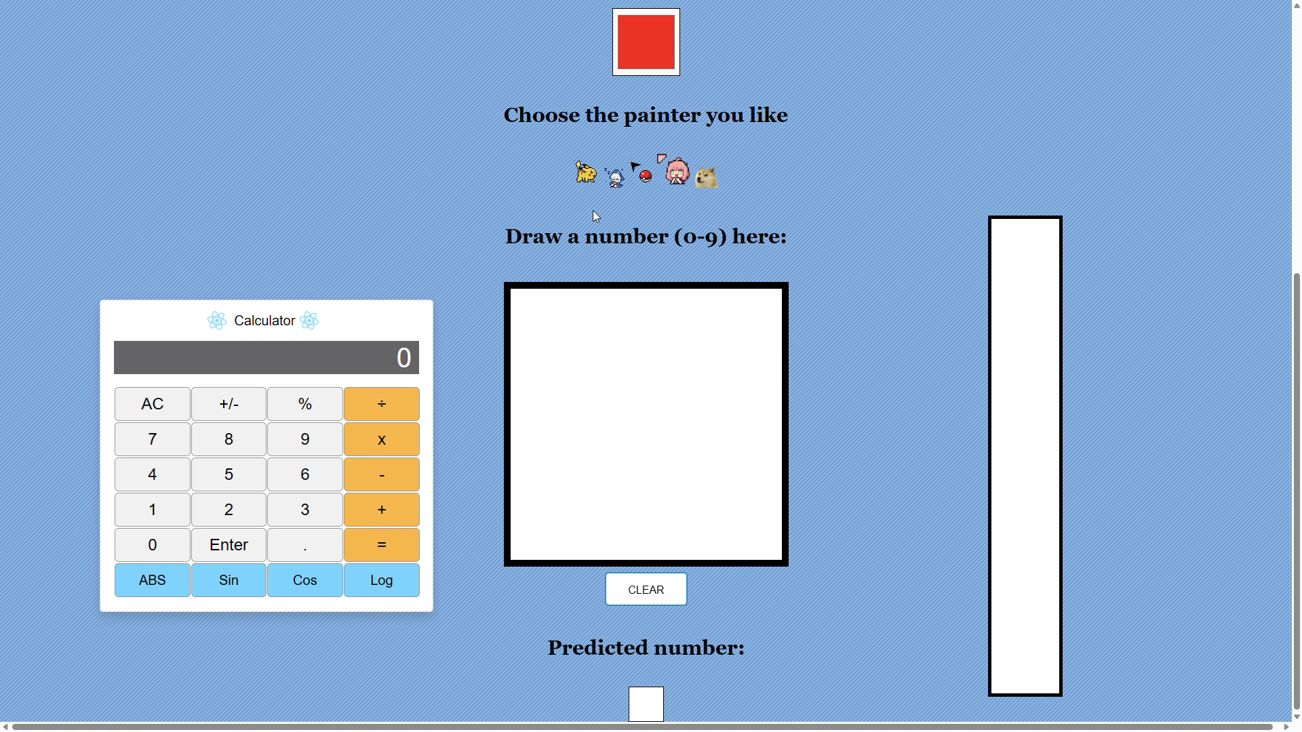
(a) Painter
Notes:
成果如圖

Slide 16
(b)
Color button
(AI)

Slide 17
(b) color button
Index.js
colorpicker.js
NumberRecognition.js
drawable_canvas.js
Flow chart
Notes:
With a similar concept, we make an app for choosing the painter color. This is the component flow chart. This time, we need to get the color information from colorpicker component.
Then, we’ll follow the same process. Send the color information to drawablecanvas component
再來用類似概念再做了一個顏色選擇器，這次的組件關係圖如圖，我們首先要先從colorpicker得到顏色資訊，並將其傳給index，再利用剛剛的方法把index中顏色的state傳到drawable_canvas

Slide 18
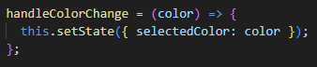
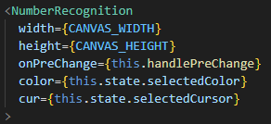
(b) color button
index.js
Notes:
In order to get the color information from child component,
need to send a function called handlecolorchange as an attribute.
為了得到子組件的值，我們需要在父組件傳入一個函式，就是handleColorChange

Slide 19
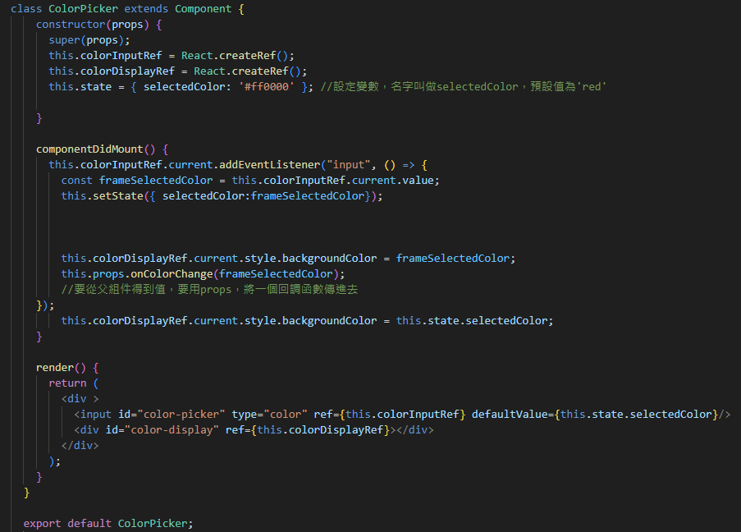
(b) color button
colorpicker.js
Notes:
Then we set a addeventlistener. While the choosing color event is triggered. The chosen color information will be sent to index.js through props.
再來到Color_picker組件中，設立一個事件監聽者，當事件監聽者得到顏色資訊以後，會將其傳入剛剛藉由attribute傳入的函式，
這時候便可以改變index的顏色state

Slide 20
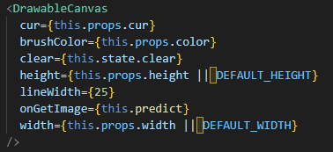
(b) color button
number-recognition.js
Notes:
with the same concept as above. We sent the color information to drawable canvas component through attribute
之後，藉由剛剛一樣的方式，把顏色資訊藉由attribute傳到Drawable_Canvas組件

Slide 21
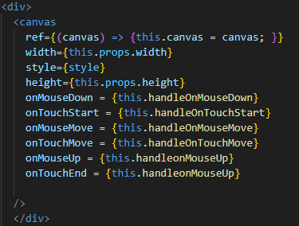
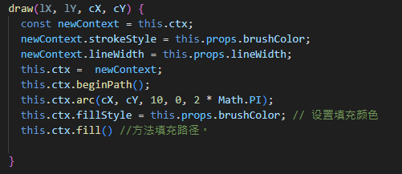
(b) color button
drawable_canvas.js
Notes:
In addition to the color information, we also need to set the drawing function.
That is, we can make a canvas for drawing by the painter and the color we like.
然後我們要把顏色設置到筆刷顏色以外，還要設定在畫布上畫圖時的功能，如此一來，我們便可以在做出一個畫布，並藉由我們喜歡的筆刷樣式及顏色畫圖

Slide 22
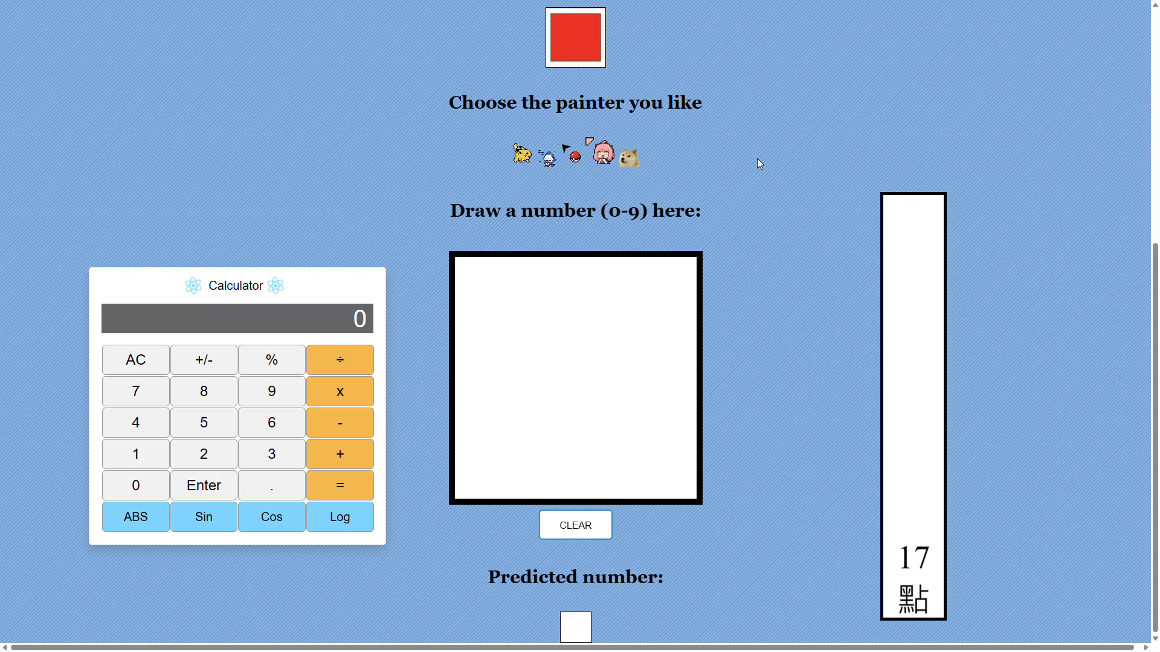
(b) Color button
Notes:
成果如圖

Slide 23
(c)
Calculator
(AI)

Slide 24
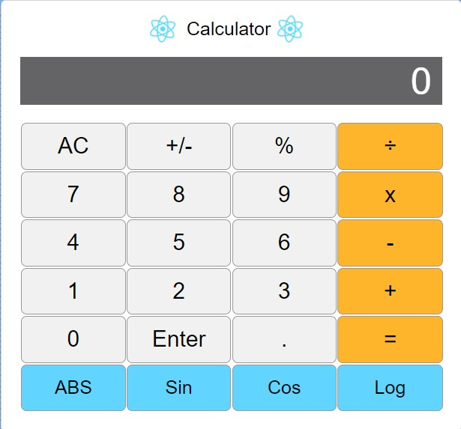
(c) Calculator

Slide 25
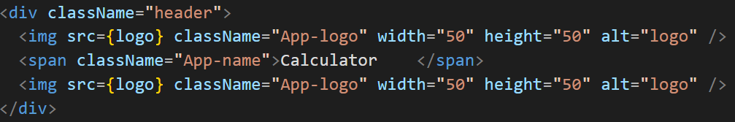
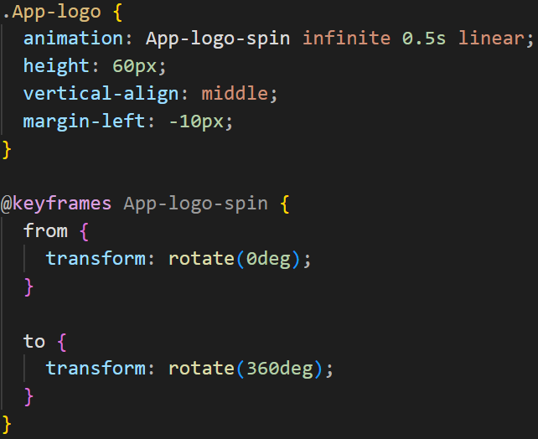
(c) Calculator
ButtonPanel.js
ButtonPanel.css

Slide 26
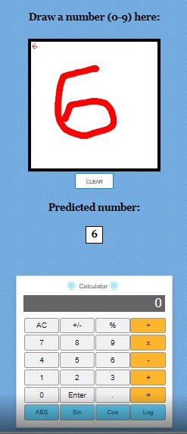
(c) Calculator

Slide 27
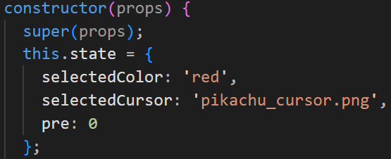
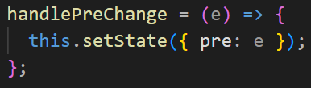
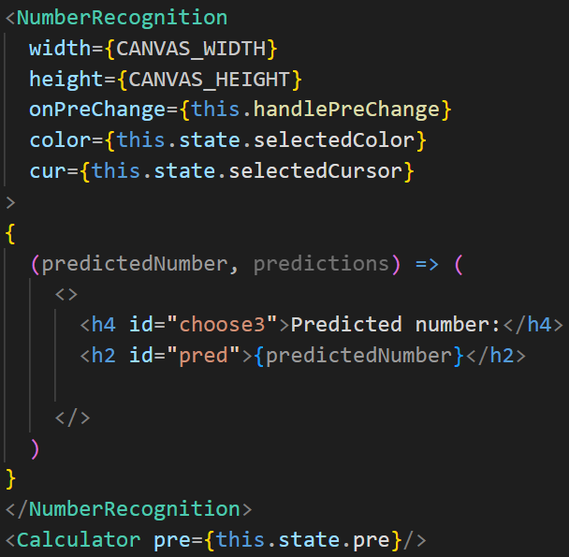
(c) Calculator
number-recognition.js
index.js

Slide 28
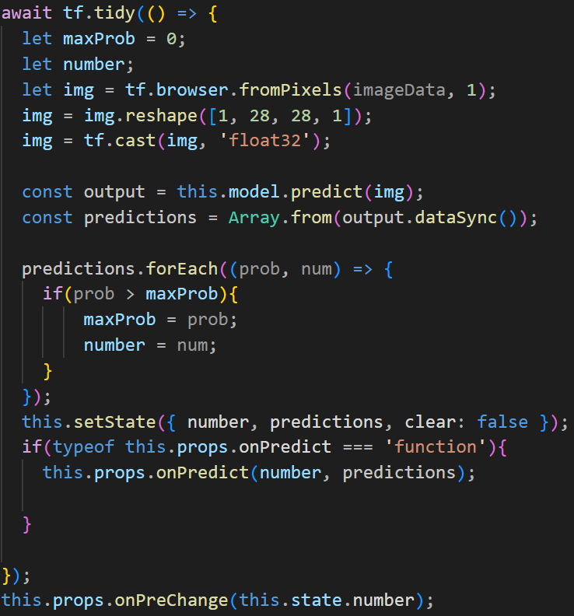
(c) Calculator
number-recognition.js

Slide 29
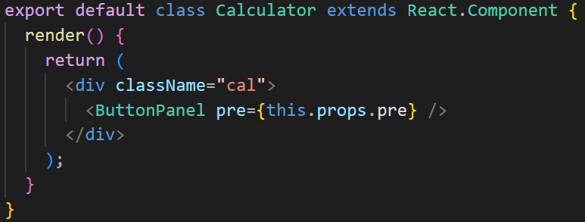
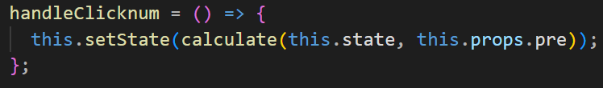
(c) Calculator
calculator.js
ButtonPanel.js
ButtonPanel.js

Slide 30
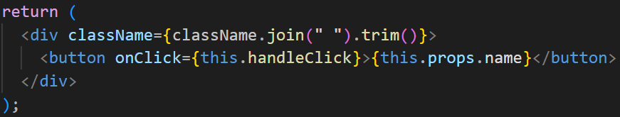
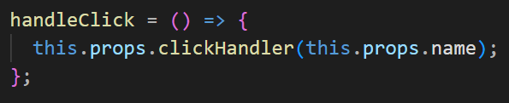
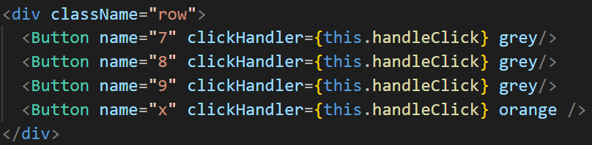
(c) Calculator
Button.js
Button.js
ButtonPanel.js

Slide 31
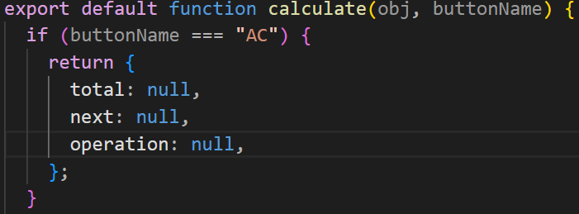
(c) Calculator
calculate.js

Slide 32
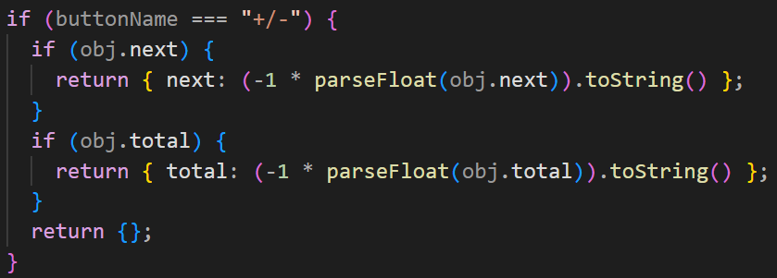
(c) Calculator
calculate.js

Slide 33
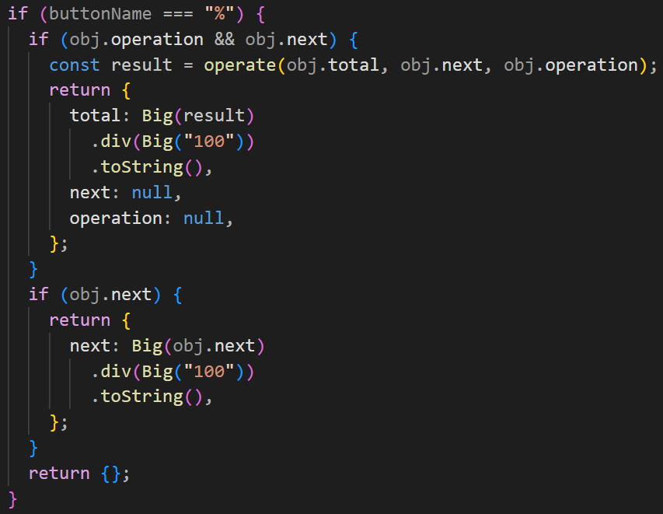
(c) Calculator
calculate.js

Slide 34
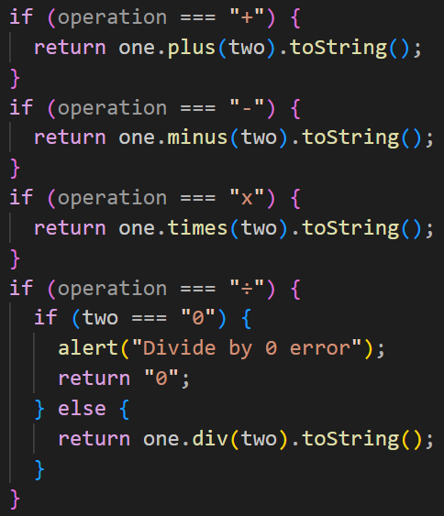
(c) Calculator
calculate.js

Slide 35
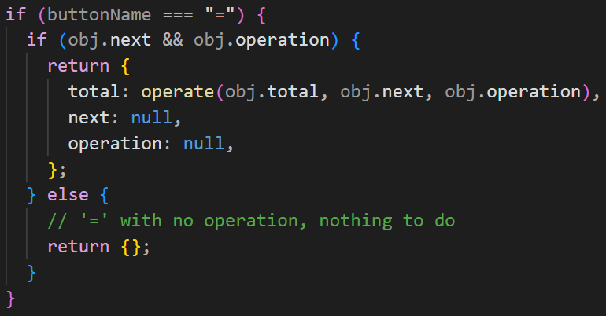
(c) Calculator
calculate.js

Slide 36
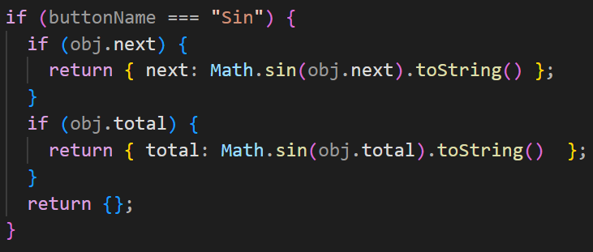
(c) Calculator
calculate.js

Slide 37
(d)
Train the model
(AI)

Slide 38
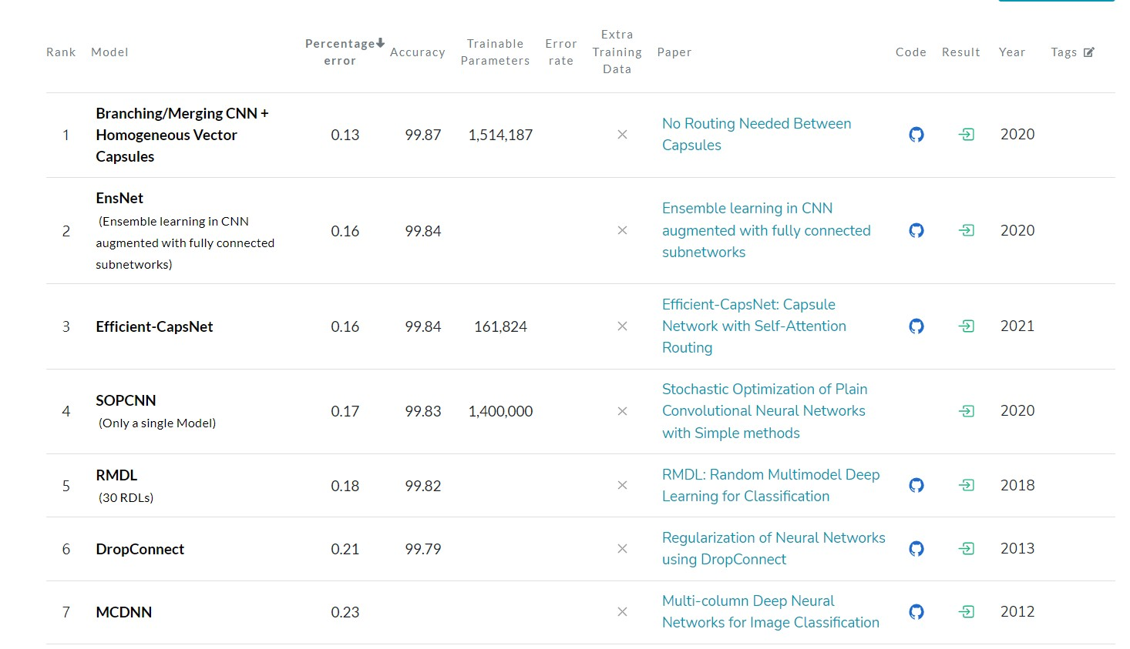
(d) Train the model
Notes:
The MNIST database (Modified National Institute of Standards and Technology database) is a large collection of handwritten digits.
The addition of multiple classification branches to the network establishes a new state of the art for the MNIST dataset with an accuracy of 99.87% for an ensemble of these models, as well as establishing a new state of the art for a single model

Slide 39
(e)
Model compression - pruning
(AI)

Slide 40
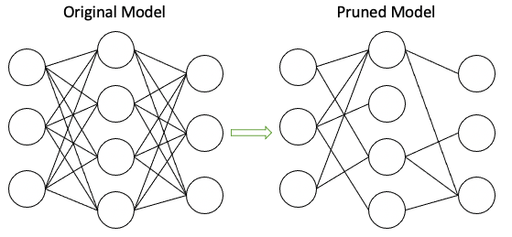
Model Pruning Key Aspects
Models contain redundant or unnecessary parameters that can be removed without significantly impacting their performance.
Reduce the complexity and size of the model while maintaining or even improving its accuracy and efficiency.

Slide 41
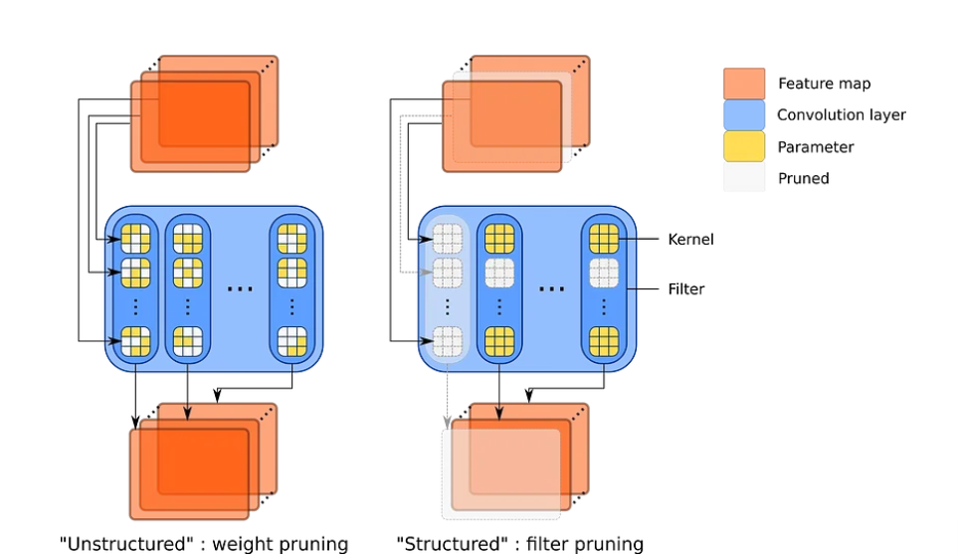
Pruning structures
Unstructured pruning
structured pruning
Notes:
Directly pruning parameters has many advantages. First, it is simple, since replacing the value of their weight with zero, within the parameter tensors, is enough to prune a connection. Widespread deep learning frameworks, such as Pytorch, allow to easily access all the parameters of a network, making it extremely simple to implement. Still, the greatest advantage of pruning connections remains yet that they are the smallest, most fundamental elements of networks and, therefore, they are numerous enough to prune them in large quantities without impacting performance. Such a fine granularity allows pruning very subtle patterns, up to parameters within convolution kernels, for example. As pruning weights is not limited by any constraint at all and is the finest way to prune a network, such a paradigm is called unstructured pruning.
Therefore, not only are such networks lighter to store, due to fewer parameters, but also they require less computations and generate lighter intermediate representations, hence needing less memory during runtime. Actually, it is sometimes more beneficial to reduce bandwidth rather than the parameter count. Indeed, for tasks that involve large images, such as semantic segmentation or object detection, intermediate representations may be prohibitively memory-consuming, way more than the network itself. For these reasons, filter pruning is now seen as the default kind of structured pruning.

Slide 42
Difference between unstructured and structured pruning
structured pruning removes both convolution filters and rows of kernels instead of just pruning connections. This leads to fewer feature maps within intermediate representations.

Slide 43
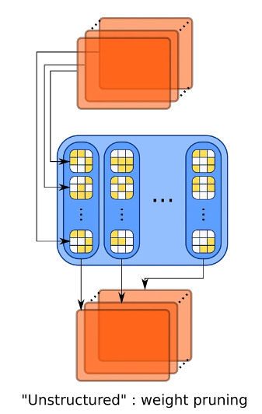
unstructured pruning drawback
Most frameworks and hardware cannot accelerate sparse matrices’ computation, meaning that no matter how many zeros you fill the parameter tensors with, it will not impact the actual cost of the network. What does impact it is pruning in a way that directly alters the very architecture of the network, which any framework can handle.

Slide 44
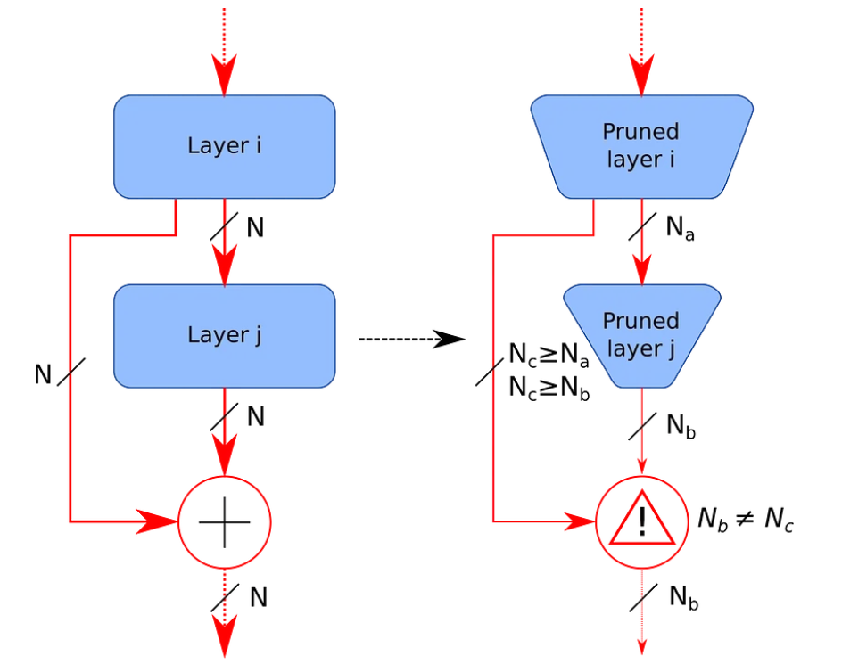
structured pruning drawback
Altering the input and output dimensions of layers can lead to some discrepancies. On the left, both layers output the same number of feature maps, that can be summed up well afterward, their pruned counterparts on the right produce intermediate representations of different dimensions, that cannot be summed up without processing them.

Slide 45
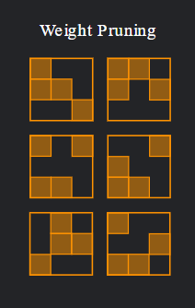
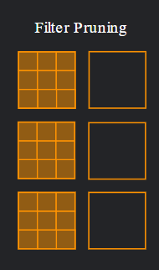
Pruning criteria
Weight magnitude criterion
Gradient magnitude pruning
Notes:
Once one has decided what kind of structure to prune, the next question one may ask could be: “how do I figure out which ones to keep and which ones to prune?”. To answer that one needs a proper pruning criteria, that will rank the relative importance of the parameters, filters or else.

Slide 46
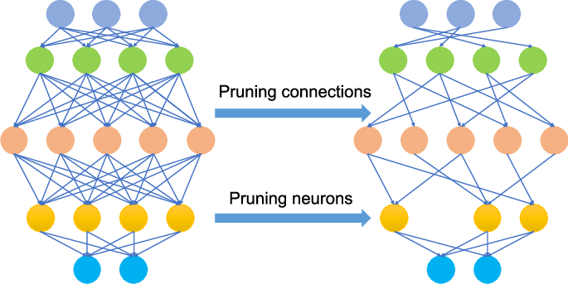
Weight magnitude criterion
One criterion that is quite intuitive and surprisingly efficient is pruning weights whose magnitude is the smallest. Under the constraint of a weight-decay, those which do not contribute significantly to the function are expected to have their magnitude shrink during training. Therefore, the superfluous weights are expected to be those of lesser magnitude.

Slide 47
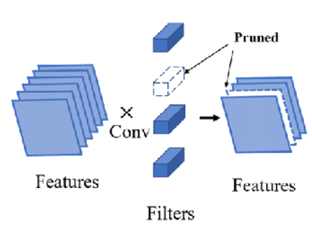
Gradient magnitude pruning
Magnitude of the weight is not the only popular criterion that exists. The other main criterion to have lasted up to now is the magnitude of the gradient. Some fundamental works theorized, through a Taylor decomposition of the impact of removing a parameter on the loss, that some metrics, derived from the back-propagated gradient, may provide a good way to determine which parameters could be pruned without damaging the network.

Slide 48
Model Pruning Key Aspects
Redundancy
Importance estimation
Sparse representation
Fine-tuning
Trade-off between

Slide 49
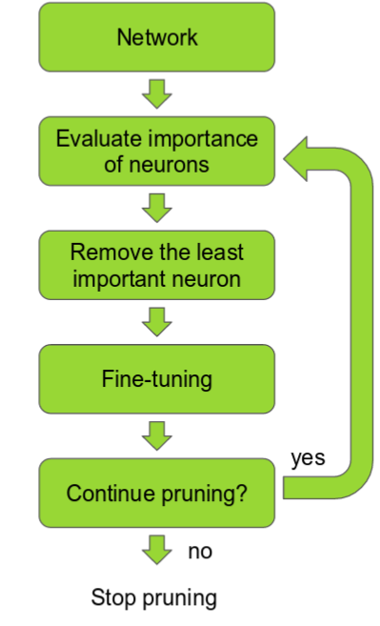
Model Pruning Steps - Redundancy
Redundancy: DL Models often contain redundant parameters that can be pruned or removed without sacrificing the model's capabilities.
Notes:
Redundancy: Deep learning models often contain redundant parameters that do not contribute significantly to the model's representational power or performance. These redundant parameters can be pruned or removed without sacrificing the model's capabilities.

Slide 50
Model Pruning Steps - Importance estimation
Importance estimation: Evaluating the importance or contribution of each parameter in the model.
Notes:
Importance estimation: Model pruning requires evaluating the importance or contribution of each parameter in the model. Various criteria can be used to estimate the importance, such as weight magnitudes, gradients, or sensitivity analysis. Parameters that are deemed less important or have a smaller impact on the model's performance can be pruned.

Slide 51
Model Pruning Steps - Sparse representation
Sparse representation: Pruning aims to increase the sparsity of the model by removing unnecessary parameters.
Notes:
Sparse representation: Pruning aims to increase the sparsity of the model by removing unnecessary parameters. A sparse model has a significant number of zero-valued parameters, which leads to computational efficiency during inference. This sparsity can be leveraged to reduce memory requirements and accelerate computation.

Slide 52
Model Pruning Steps - Fine-tuning
Fine-tuning: Fine-tuning helps the pruned model improve its performance by allowing the remaining parameters to adapt and compensate for the pruned connections.
Notes:
Fine-tuning: After pruning, the pruned model is often fine-tuned or retrained using the original training data or a subset of it. Fine-tuning helps the pruned model regain or improve its performance by allowing the remaining parameters to adapt and compensate for the pruned connections.

Slide 53
Model Pruning Steps - Trade-off
Trade-off between size and performance: The goal is to achieve an optimal trade-off between model size, computational efficiency, and accuracy.
Notes:
Trade-off between size and performance: Model pruning involves finding the right balance between model size reduction and maintaining acceptable performance. Pruning too aggressively may result in a loss of accuracy, while being too conservative may not yield significant size reduction. The goal is to achieve an optimal trade-off between model size, computational efficiency, and accuracy.

Slide 54
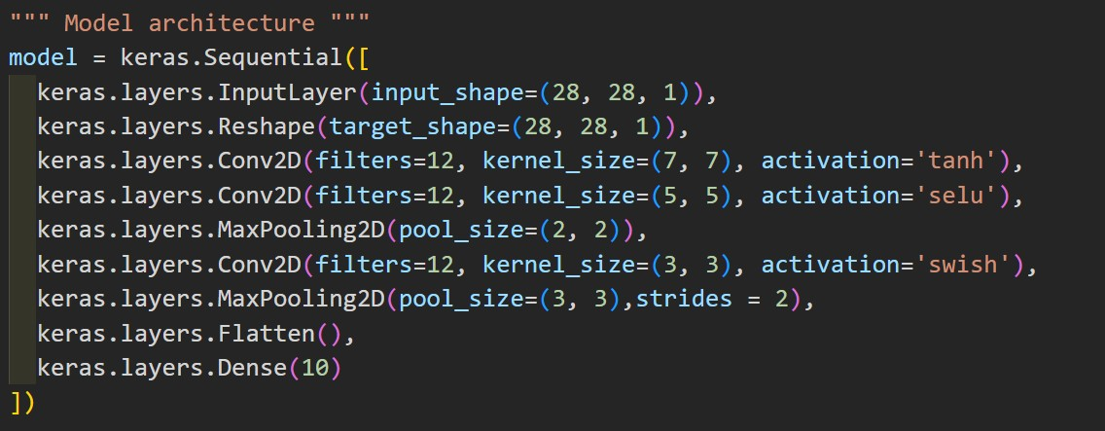
Model Architecture

Slide 55
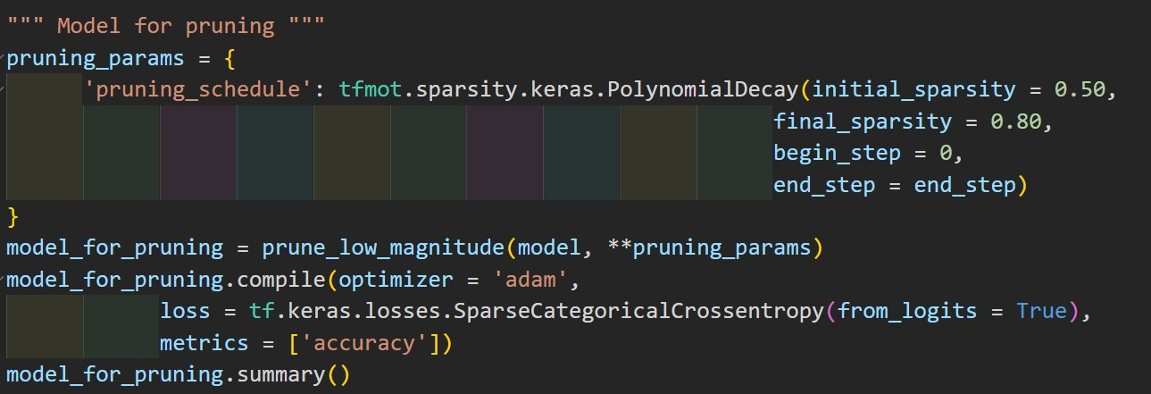
Pruning Model
Notes:
tfmot.sparsity.keras.PolynomialDecay

Slide 56
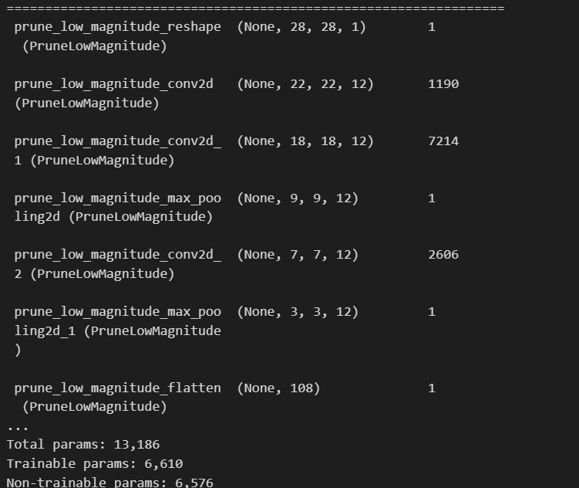
Model Summary

Slide 57
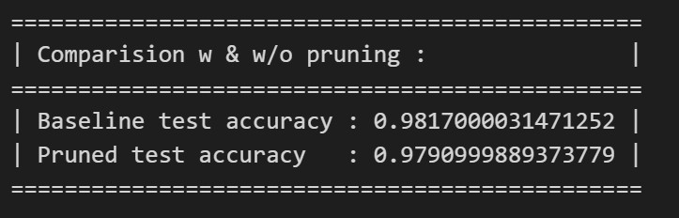
Final Result Compare

Slide 58
(e)
Model compression - Knowledge Distillation
(AI)

Slide 59
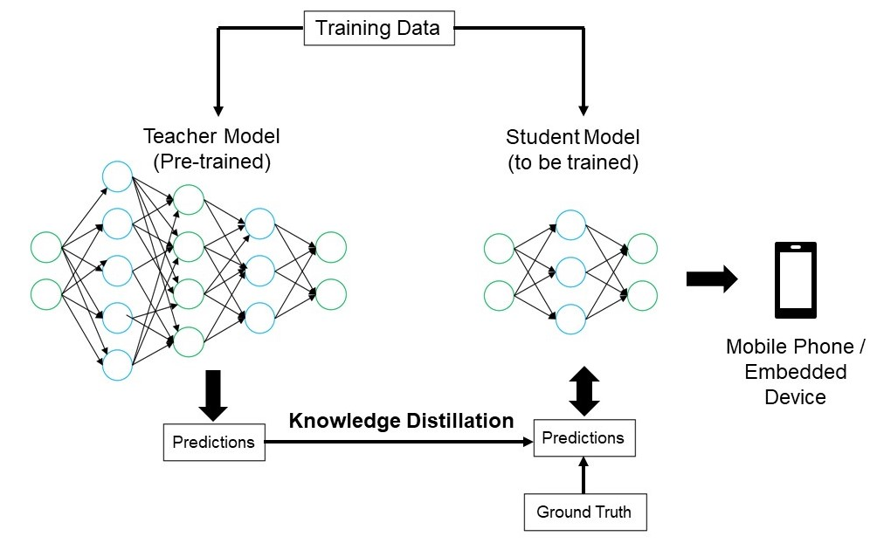
Knowledge Distillation key
(1) This knowledge transfer process helps improve the student model's generalization ability and prediction performance.
(2) The teacher model is usually more complex and accurate, while the student model is simplified and more efficient.
(3) By distilling the knowledge of the teacher model, the student model can achieve performance close to that of the teacher model with a relatively smaller model capacity.
Notes:
Knowledge distillation is a technique in machine learning .it transfers knowledge from a larger complex model to a smaller, simpler model. The large model we call as the "teacher" model and the smaller simpler model referred to as the "student" model. The goal of knowledge distillation is to train a compact model that can approximate the behavior of the larger model while being more computationally efficient

Slide 60
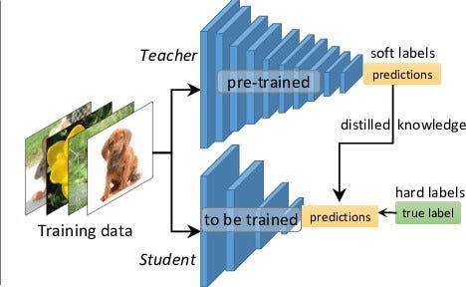
Knowledge Distillation process
(1) Use the large teacher model to make predictions on the training data.
(2) Use the teacher model‘s predictions as additional targets along with the true labels to train the student model.
(3) Train the student model by minimizing the difference between the student model's predictions and the teacher model's predictions.
(4) The student model learns both the true labels and the predictive knowledge of the teacher model during training.
Notes:
The process of Knowledge distillation typically train the teacher’s model by a large dataset, then use the teacher’s model result as the “soft target” to guide the training of the student model. The soft target is the distribution over the classes. Using soft target can provide more informative data to the student model during training. Then the student model will try to imitate the behavior of the teacher’s model by minimizing the deference between student’s prediction and the soft target provide by teacher’s model. This way, the student model can learn from the knowledge encoded in the teacher model, such as patterns, decision boundaries. Then we can train the student model by the soft target and true label.

Slide 61
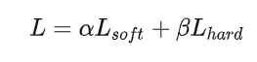
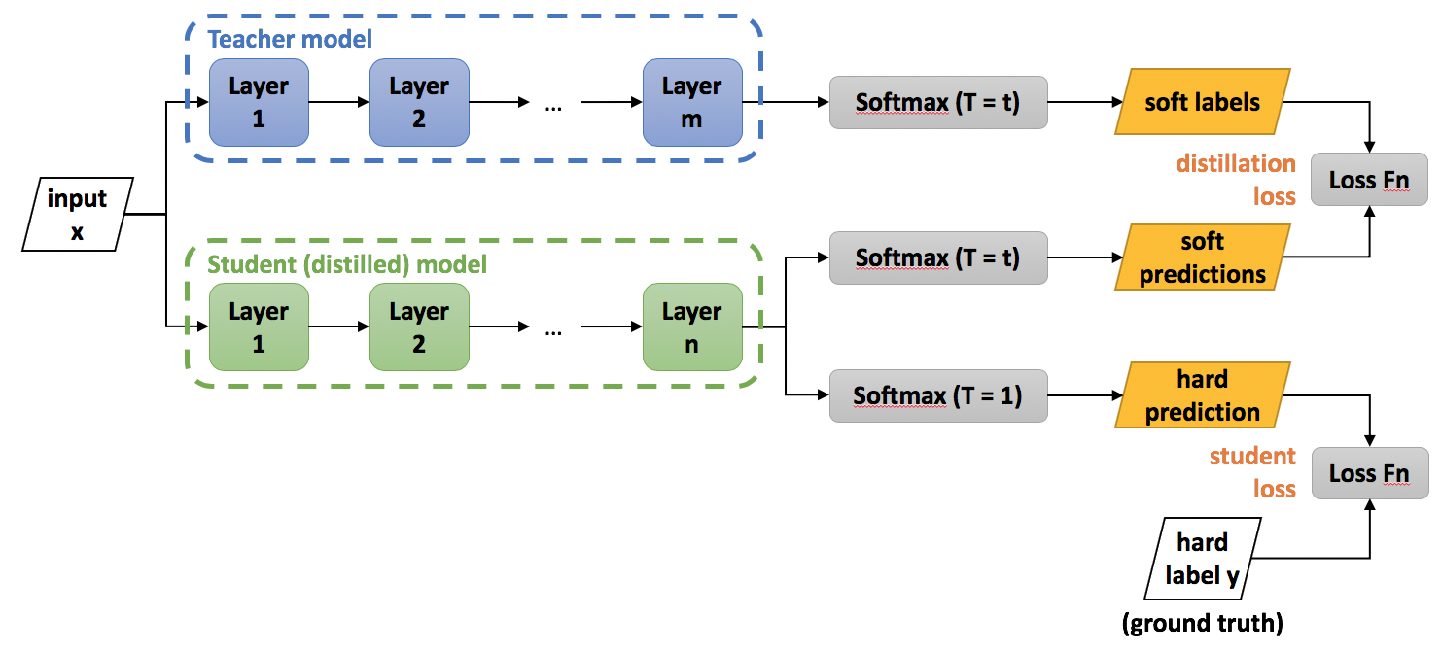
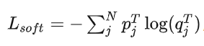



Knowledge Distillation topology
Notes:
In this KD model, we can use the loss soft target loss plus true target loss as the total loss to train the student model. The alpha and beta are hyperparameters.

Slide 62

Why we need soft target?

Slide 63


Temperature
Notes:
The soft target loss is depending on a parameter which is call temperature. The temperature parameter T controls the softness of the target probabilities. Higher values of T produce softer targets, where the predicted probabilities are more evenly distributed across the classes. This encourages the student model to learn from the general knowledge of the teacher model, including the relationships between different classes. From our result we can see as the temperature increase, the student model performance will increase as well.

Slide 64

Teacher’s model

Slide 65


Student’s model

Slide 66

KD result

Slide 67


Tensorflow.js
Training model
In python env
Using tensorflow.js to load the model
Model.json &
model parameters

Slide 68
04
Future work
(AI)

Slide 69
Future work
Change the input image type (not just limited to handwriting)
Connect picture recognition with daily use.
Model compression
Run app in smartphone
Notes:
In the recent year, artificial inte

Slide 70
Thank you for listening!

Slide 71
Reference
[1] https://www.tensorflow.org/js?hl=zh-tw
[2] https://react.dev/
[3] https://zh-hant.legacy.reactjs.org/
[4] https://www.w3schools.com/html/default.asp
[5] https://reactjsexample.com/tag/calculator/

Slide 72
Reference
[6] https://paperswithcode.com/sota/image-classification-on-mnist
[7] https://towardsdatascience.com/model-compression-via-pruning-ac9b730a7c7b
[8] https://github.com/stevenyst/MNIST_React_TensorFlowJS
[9] [2303.08986] Deep Learning Weight Pruning with RMT-SVD: Increasing Accuracy and Reducing Overfitting
[10] [1503.02531] Distilling the Knowledge in a Neural Network
[11] https://www.tensorflow.org/model_optimization/guide/pruning/comprehensive_guide

